Slide 1
The Drift Diffusion Simulation of Coupled Ionic-Electronic Devices
By: Cem Bonfil

Slide 2
Overview
What is an ionic electronic device ?
General Equations
Application of Finite Difference
Memristor
1-D and 2-D Memristor Simulations
2-D Simulation vs. Experimental Results
Conclusion

Slide 3
1-What is an ionic electronic device ?
Electrical behavior determined by the movement of mobile charged particles
Ions, holes and electrons
Natural: Ionic-channels in organic membranes
Engineered: Non-Volatile Memory, Organic FET, Memristor
Easy to fabricate, low operating voltage, slow

Slide 4



2- General Equations
Drift diffusion equation:
Continuity Equation:
Poisson’s Equation:

Slide 5
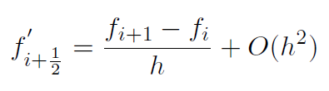


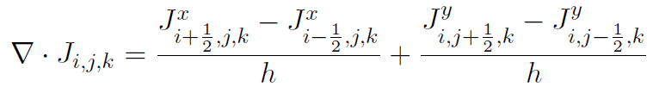

3. Application of Finite Difference
First Order Central Difference :
Second Order Central Difference:
Current Density
Continuity
Poisson’s Equation

Slide 6
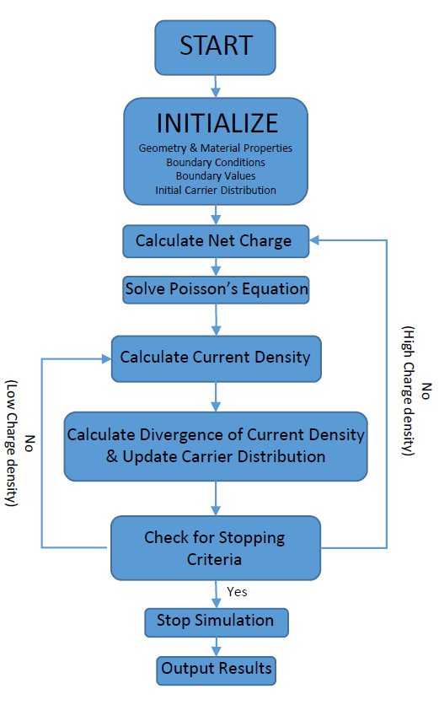
3.1- Solution Process
Figure 1: Finite Difference Drift Diffusion Solver Flowchart

Slide 7
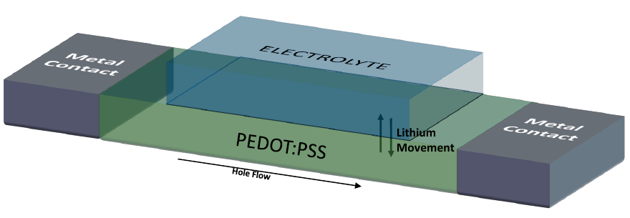
4- Memristor
Charge controlled resistor with memory
Equation: M(q(t)) = V(t)/I(t)
2 Distinct types
Organic: Based on PEDOT:PSS
Inorganic: Based on TiO2
Figure 2: An organic memristor with electrolyte and PEDOT:PSS (not to scale)

Slide 8
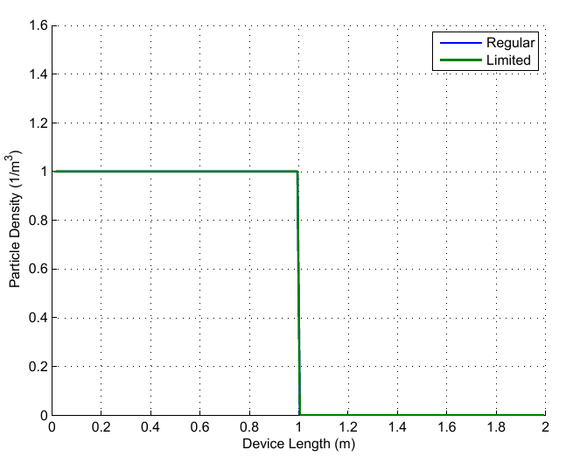
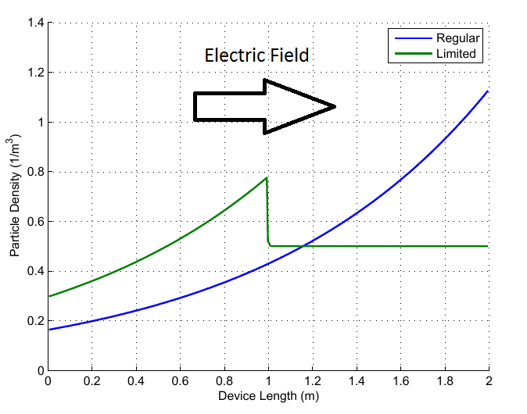
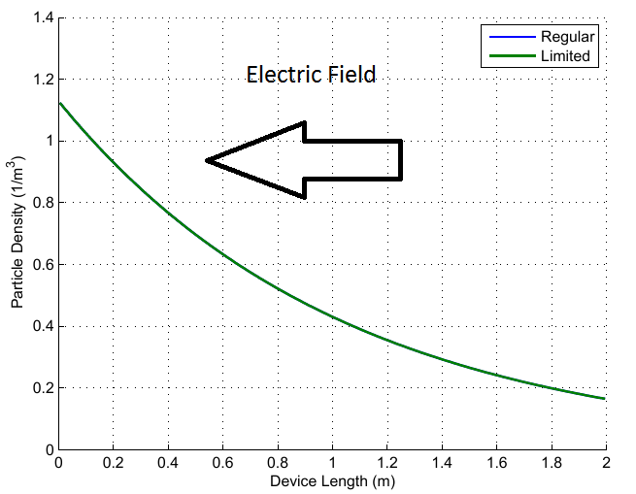
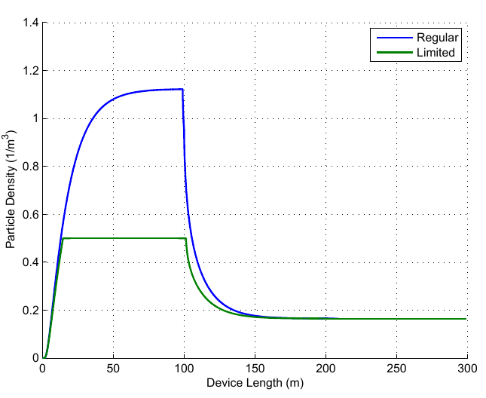
4.1- Density Limiting Mechanism
Pre calculate the next time step
Check for saturation
Set influx to zero (saturation)
Do nothing (no saturation)
Update carrier densities
Figure 3: Initial particle density
Figure 4: Density accumulation (right wall)
Figure 5: Density accumulation (left wall)
Figure 6: Density accumulation over time

Slide 9
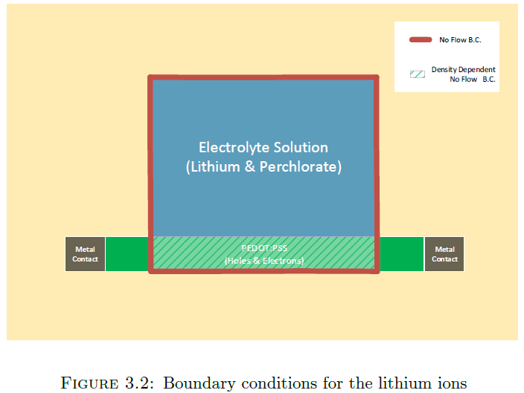
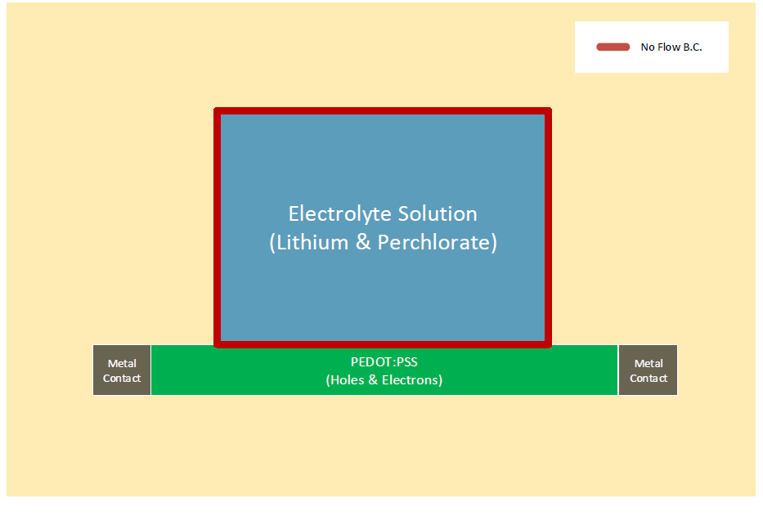
4.2- BoundarY conditions
Figure 7: Boundary condition for lithium ions
Figure 8: Boundary condition for perchlorate ions

Slide 10
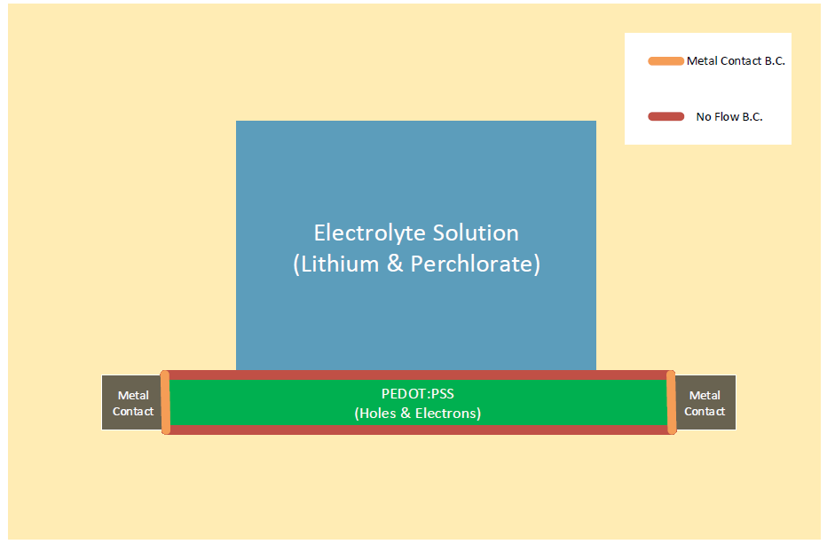
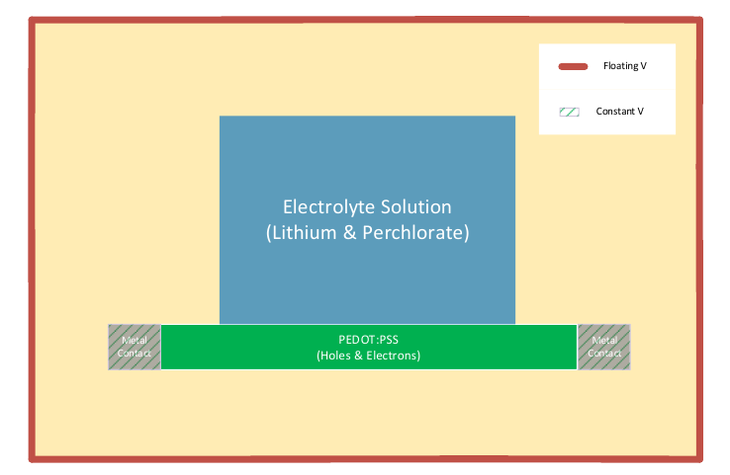
4.2- BoundarY conditions
Figure 9: Boundary condition for holes
Figure 10: Boundary condition for electric potential
Notes:
Add E,V Boundary conditions

Slide 11

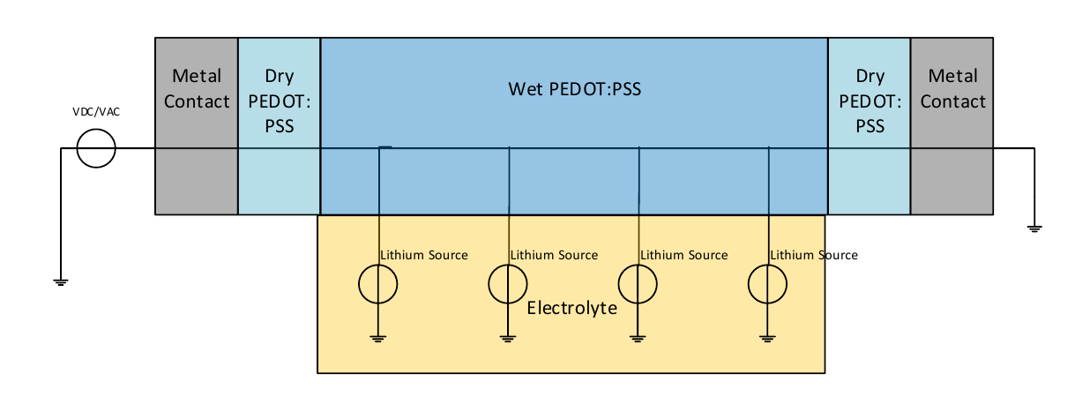


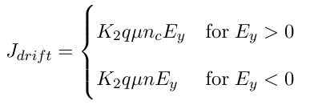
5- 1-D and 2-d memristor Simulations
Diffusion Current :
Electric Potential:
Electric Field:
Drift Current:
Figure 11: 1-D Memristor Model

Slide 12
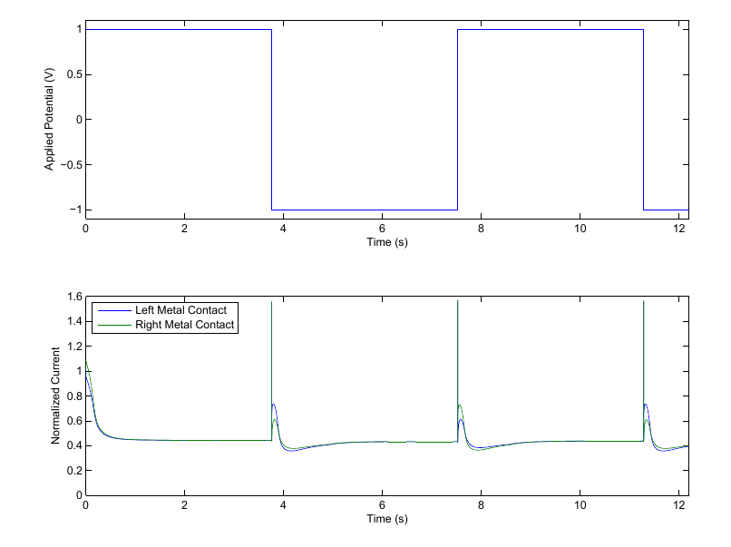
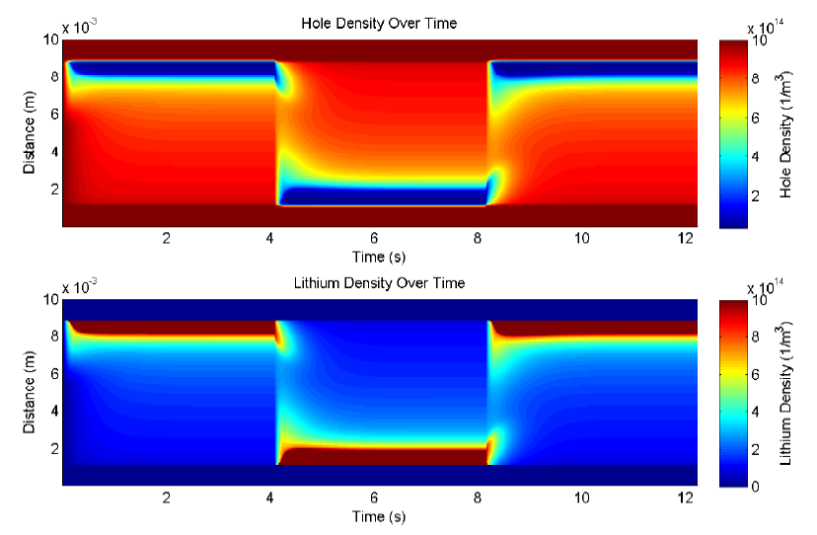
5.1 – 1-D Memristor Simulation
Figure 12: Current density over time for a potential pulse train
Figure 13: Lithium and hole density distribution over time
Notes:
Potential pulse train: Current Output, Lithium, hole density, Efield ?

Slide 13
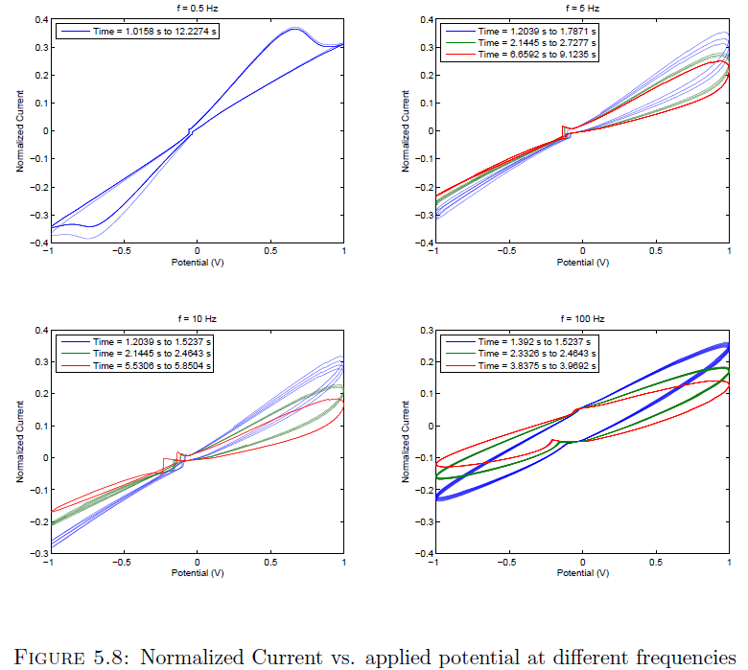
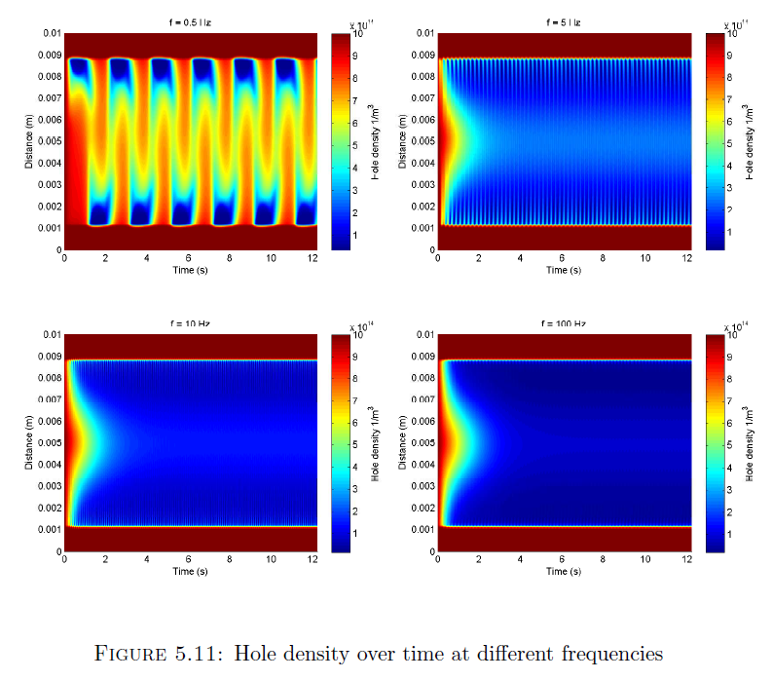
5.1 – 1-D Memristor Simulation cont.
Figure 14: Normalized current vs. applied potential at different frequencies
Figure 15: Hole density distribution over time

Slide 14
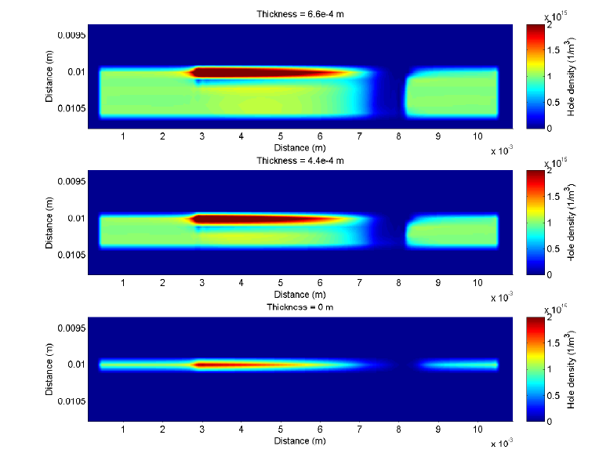
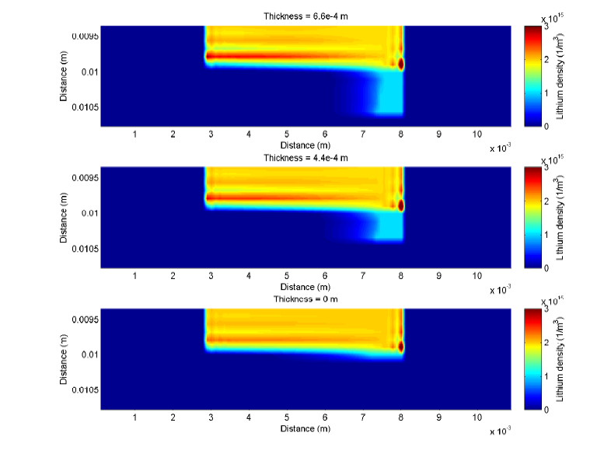
5.3- 2-D Memristor Simulations
Figure 16: Hole distribution at steady state for different PEDOT:PSS thicknesses
Figure 17: Lithium distribution at steady state for different PEDOT:PSS thicknesses

Slide 15
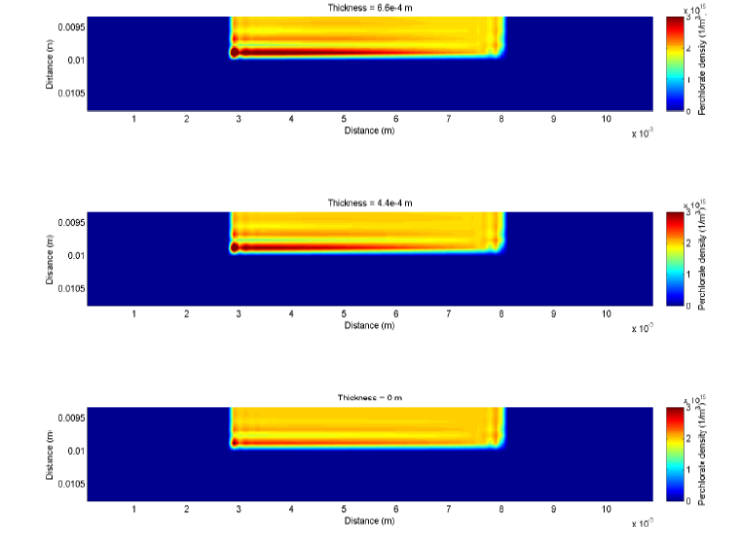
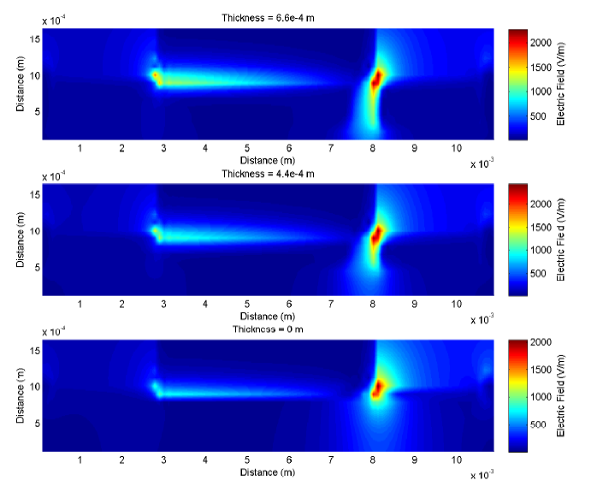
5.3- 2-D Memristor Simulations
Figure 18: Perchlorate distribution at steady state for different PEDOT:PSS thicknesses
Figure 19: Electric field strength distribution at steady state for different PEDOT:PSS thicknesses

Slide 16
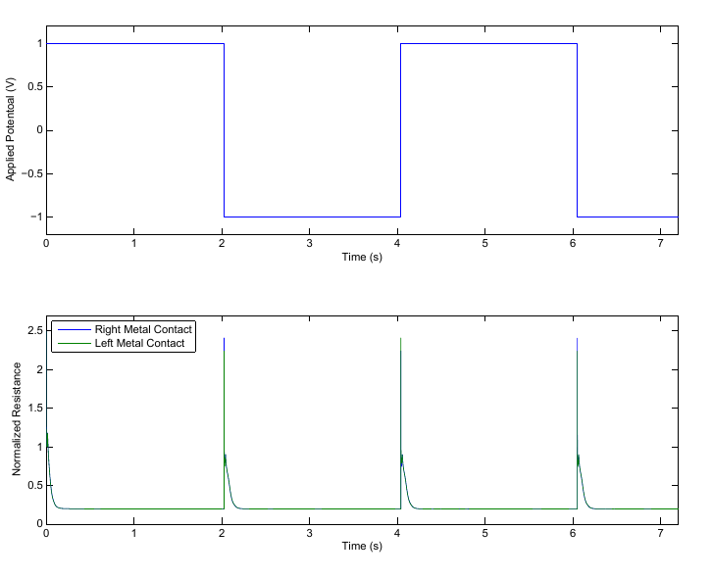
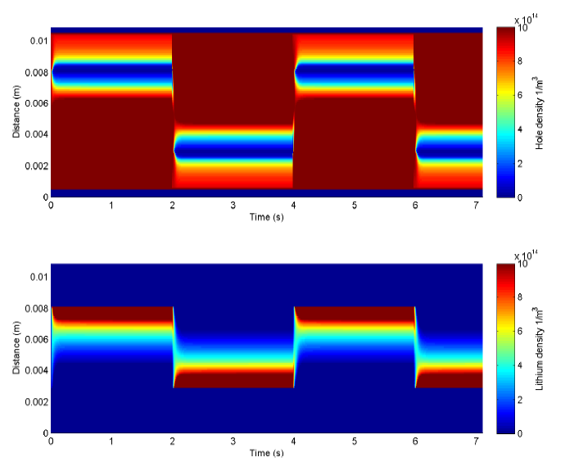
5.3- 2-D Memristor Simulations
Figure 20: Current density over time for a potential pulse train
Figure 21: Lithium and hole density distribution over time
Notes:
Potential pulse train: Current Output, Lithium, perchlorate and hole density, Efield ?

Slide 17
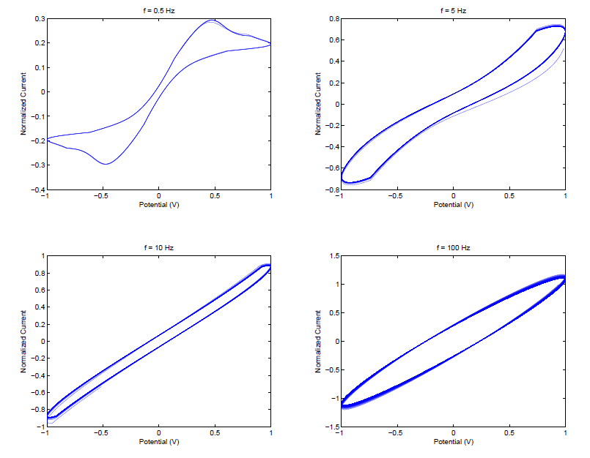
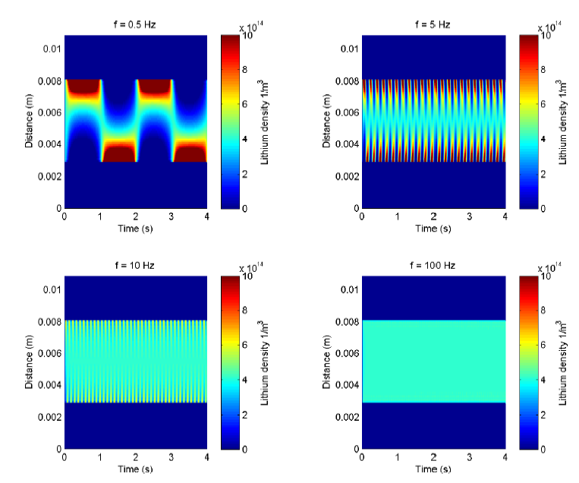
5.3- 2-D Memristor model cont.
Figure 22: Normalized current vs. applied potential at different frequencies
Figure 23: Lithium density distribution over time

Slide 18
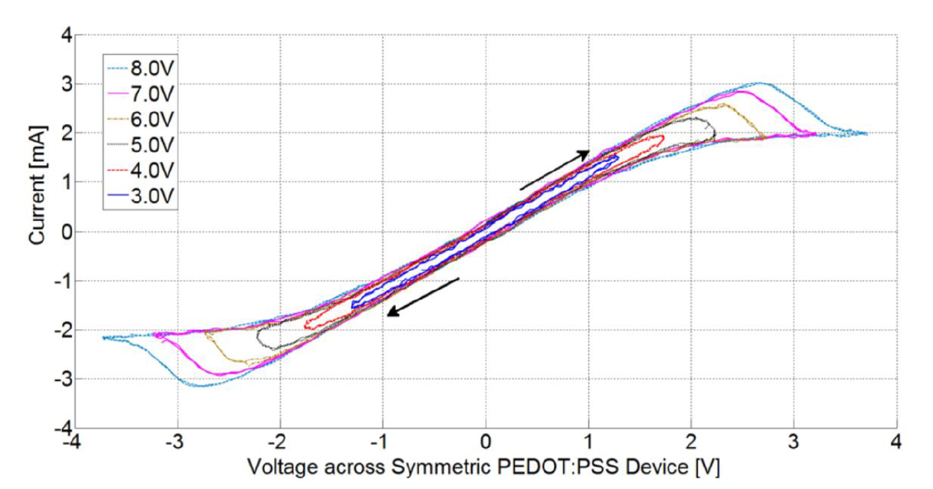
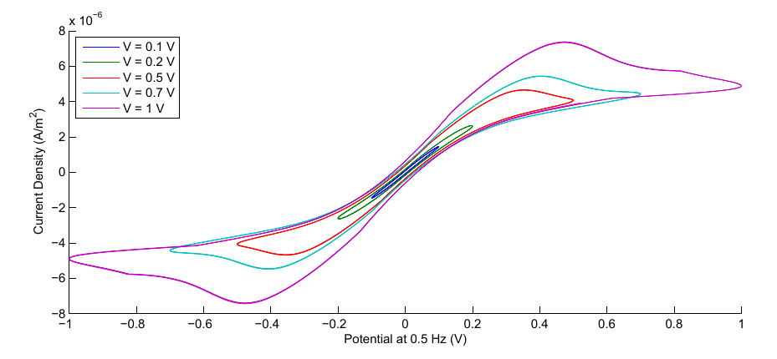
6. 2-D simulation vs. experimental results
Figure 24: Experimental results for various applied potentials at 1.0 Hz (Courtesy of Eduardo Barrera*)
Figure 25: Simulation results for various applied potentials at 0.5 Hz
*Eduardo Barrera Ramirez, Characterization of a PEDOT:PSS Electrolytic Device Using an in situ Spectroelectrochemical Technique, Master’s Thesis, 2013

Slide 19
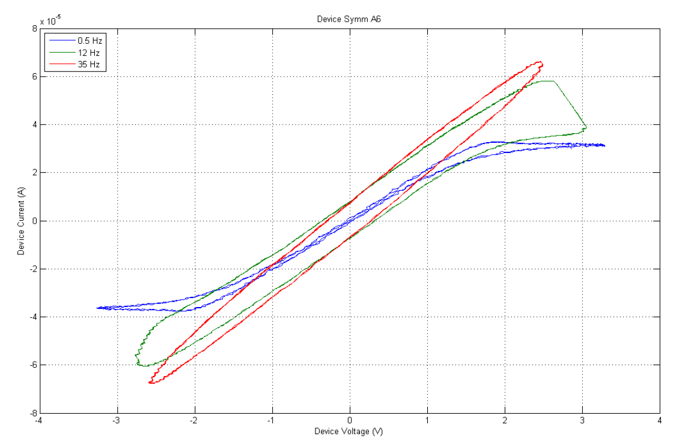
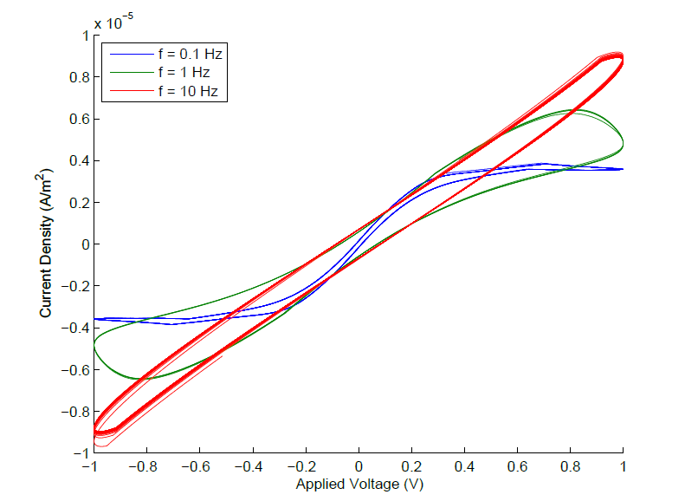
6. 2-D simulation vs. experimental results Cont.
Figure 26: Measured I-V curve at different frequencies (Courtesy of Eduardo Barrera*)
Figure 27: Measured I-V curve at different frequencies
*Eduardo Barrera Ramirez, Characterization of a PEDOT:PSS Electrolytic Device Using an in situ Spectroelectrochemical Technique, Master’s Thesis, 2013

Slide 20
7- Conclusion
Accomplishments
Simulation of a ionic electronic device
Saturation Mechanism
Experimental Verification
Future Work
Parameter fitting for 1-D and 2-D
Additional modeling of carrier transport mechanisms
Different Geometries
Further experimental verification
3D Structures

Slide 21
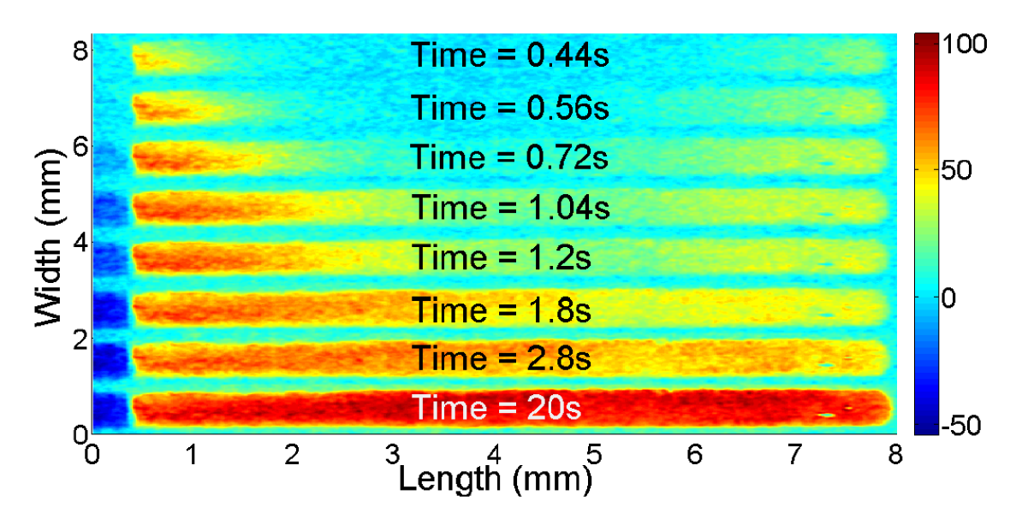
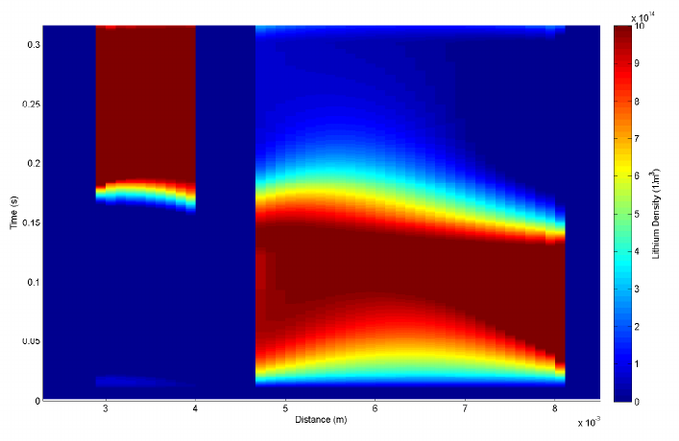
6. 2-D simulation vs. experimental results Cont.
Figure 28: Experimental results for accumulation of lithium inside PEDOT:PSS (Courtesy of Eduardo Barrera*)
Figure 29: Simulation results for accumulation of lithium inside PEDOT:PSS
*Eduardo Barrera Ramirez, Characterization of a PEDOT:PSS Electrolytic Device Using an in situ Spectroelectrochemical Technique, Master’s Thesis, 2013

Slide 22
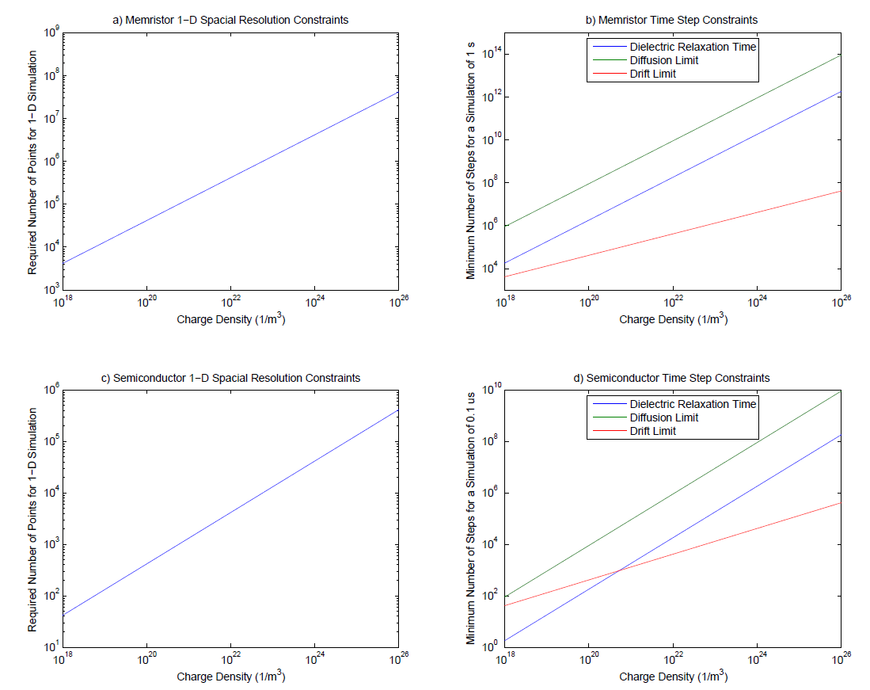
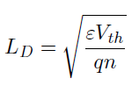



4.3- Numerical and Physical Limitations
Debye Length:
Dielectric Relaxation Time:
CFL Conditions
Drift
Diffusion:
Figure 11: Spatial and temporal requirements for a simulation

Slide 23
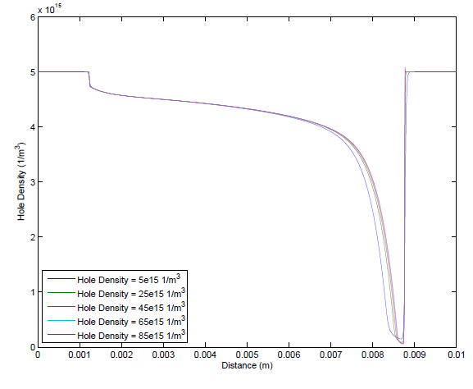
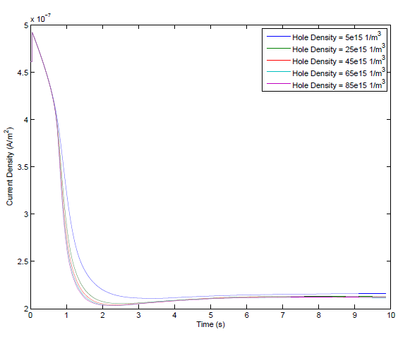
5.2- Scaling to Higher densities
Figure 17: Normalized hole densities at steady state
Figure 18: Normalized current densities

Slide 24
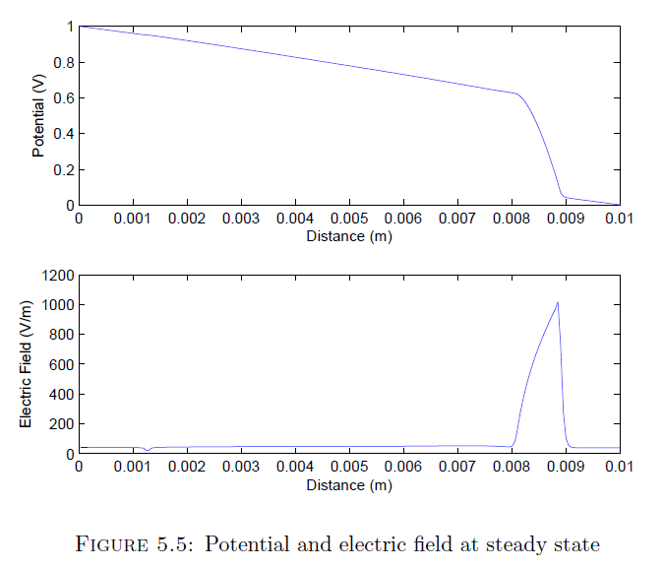
Electric Field

Slide 25
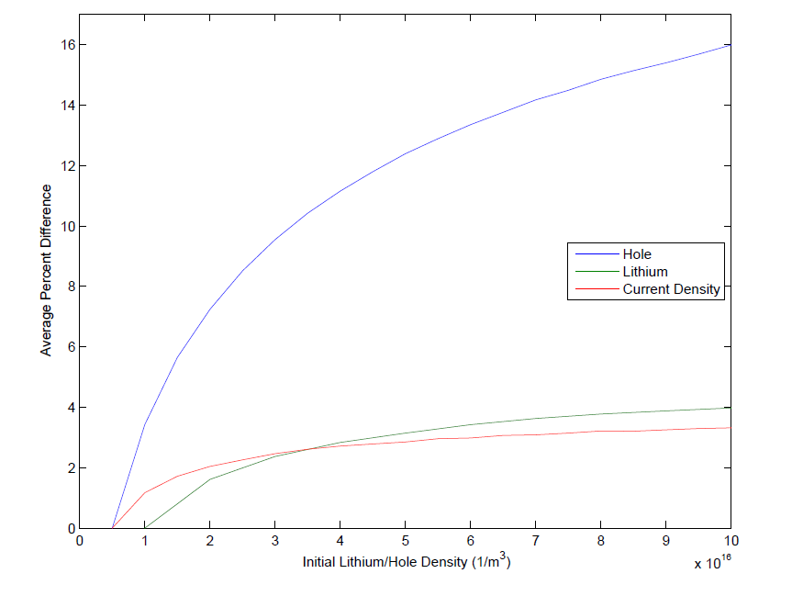
Percentage Difference

